Slide 1
Lab 08
Kayden Stiehl

Slide 2
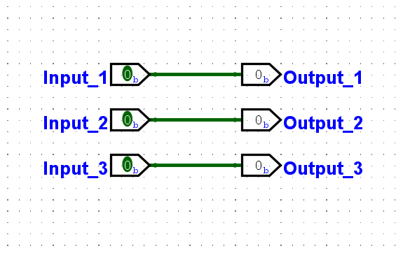
Created 3 input and three outputs for the LED in 11, 12, 13 on the arduino

Slide 3
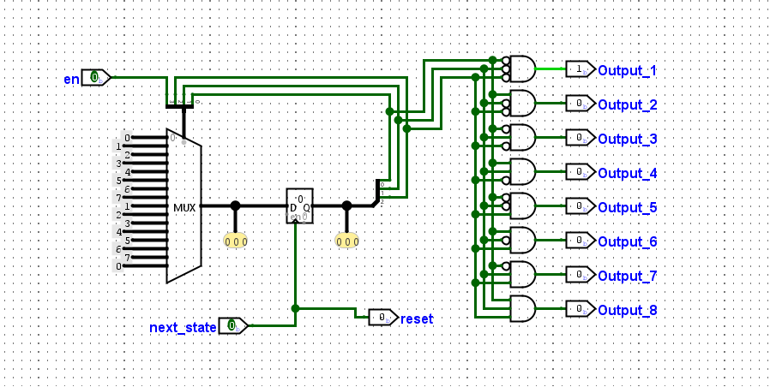
LED Switch

Slide 4
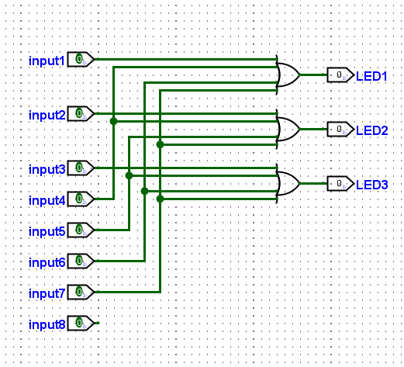
LED Reader

Slide 5
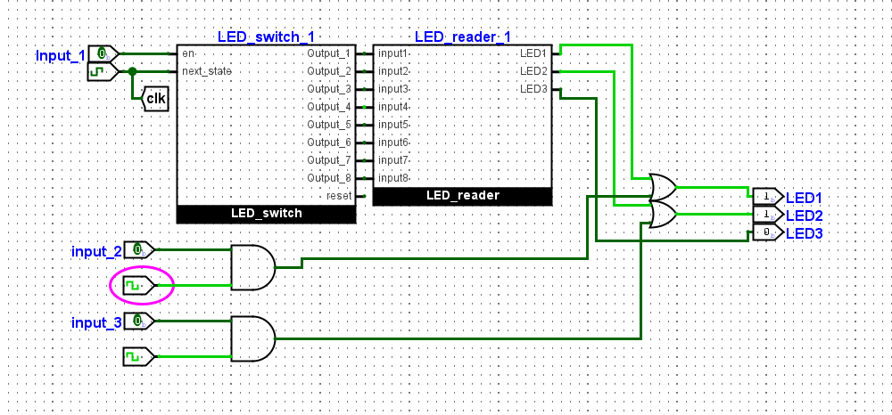
Final Result
Input one cycles through 8 different
every 8 seconds
Input two flashes blue every 1 and a
half seconds
Input three flashes green every 2 seconds
All inputs can also be going simultaneously causing a weird pattern and mix of colors

